Slide 1

Homework 10 GPS INT4023
Dalton Murray

Slide 2
Facts

Slide 3

Tracking software

Slide 4
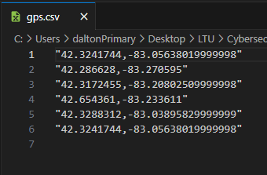
Location - GPS

Slide 5
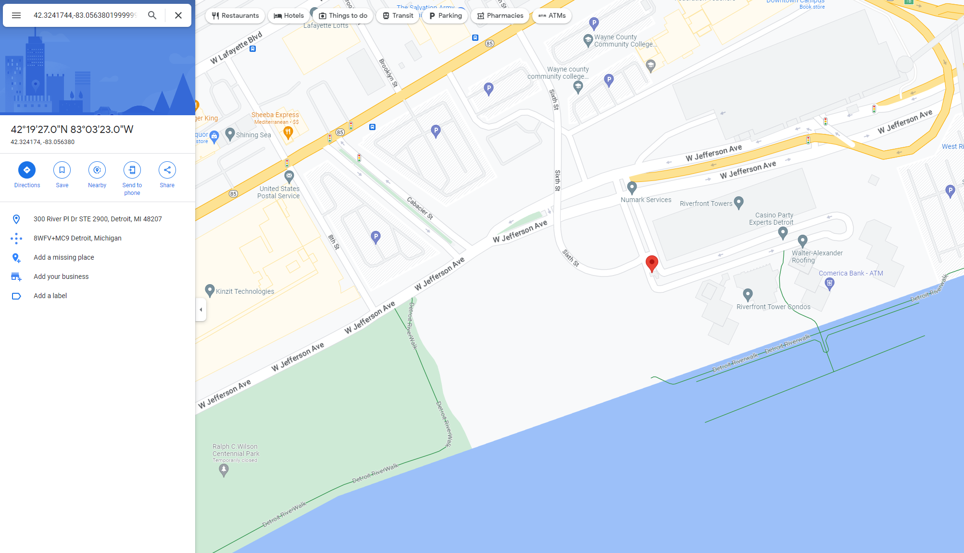
Coordinate 1

Slide 6
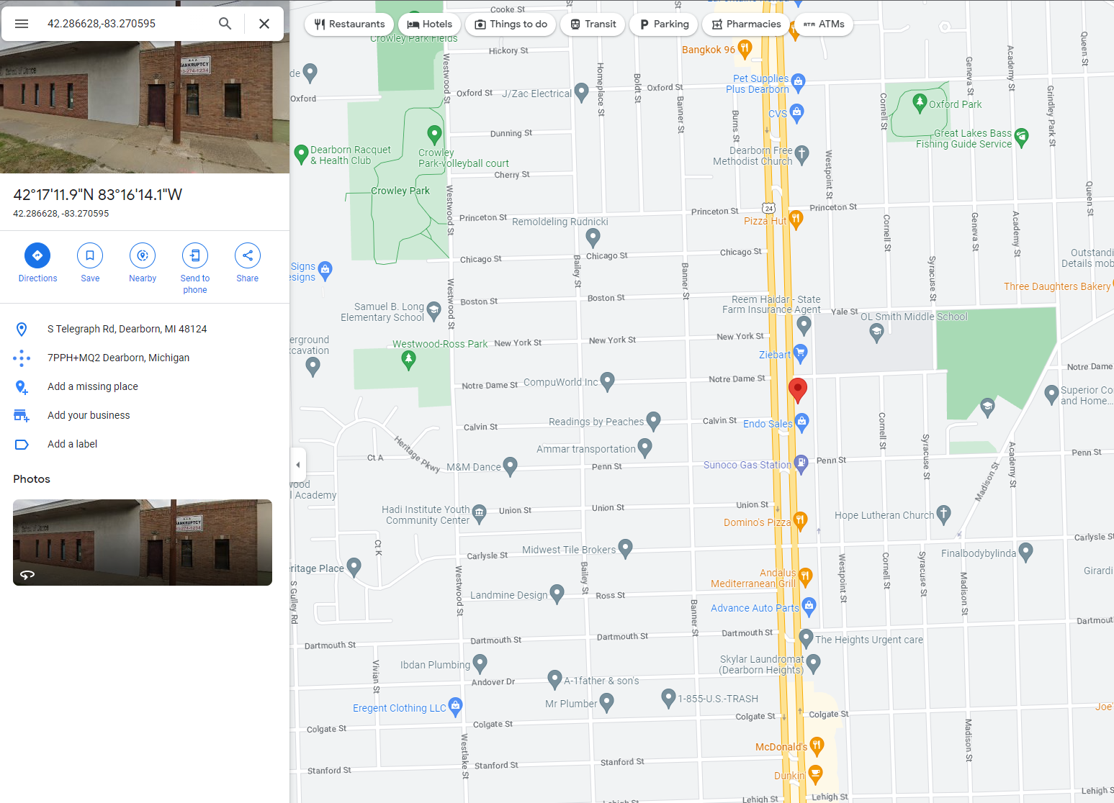
Coordinate 2

Slide 7
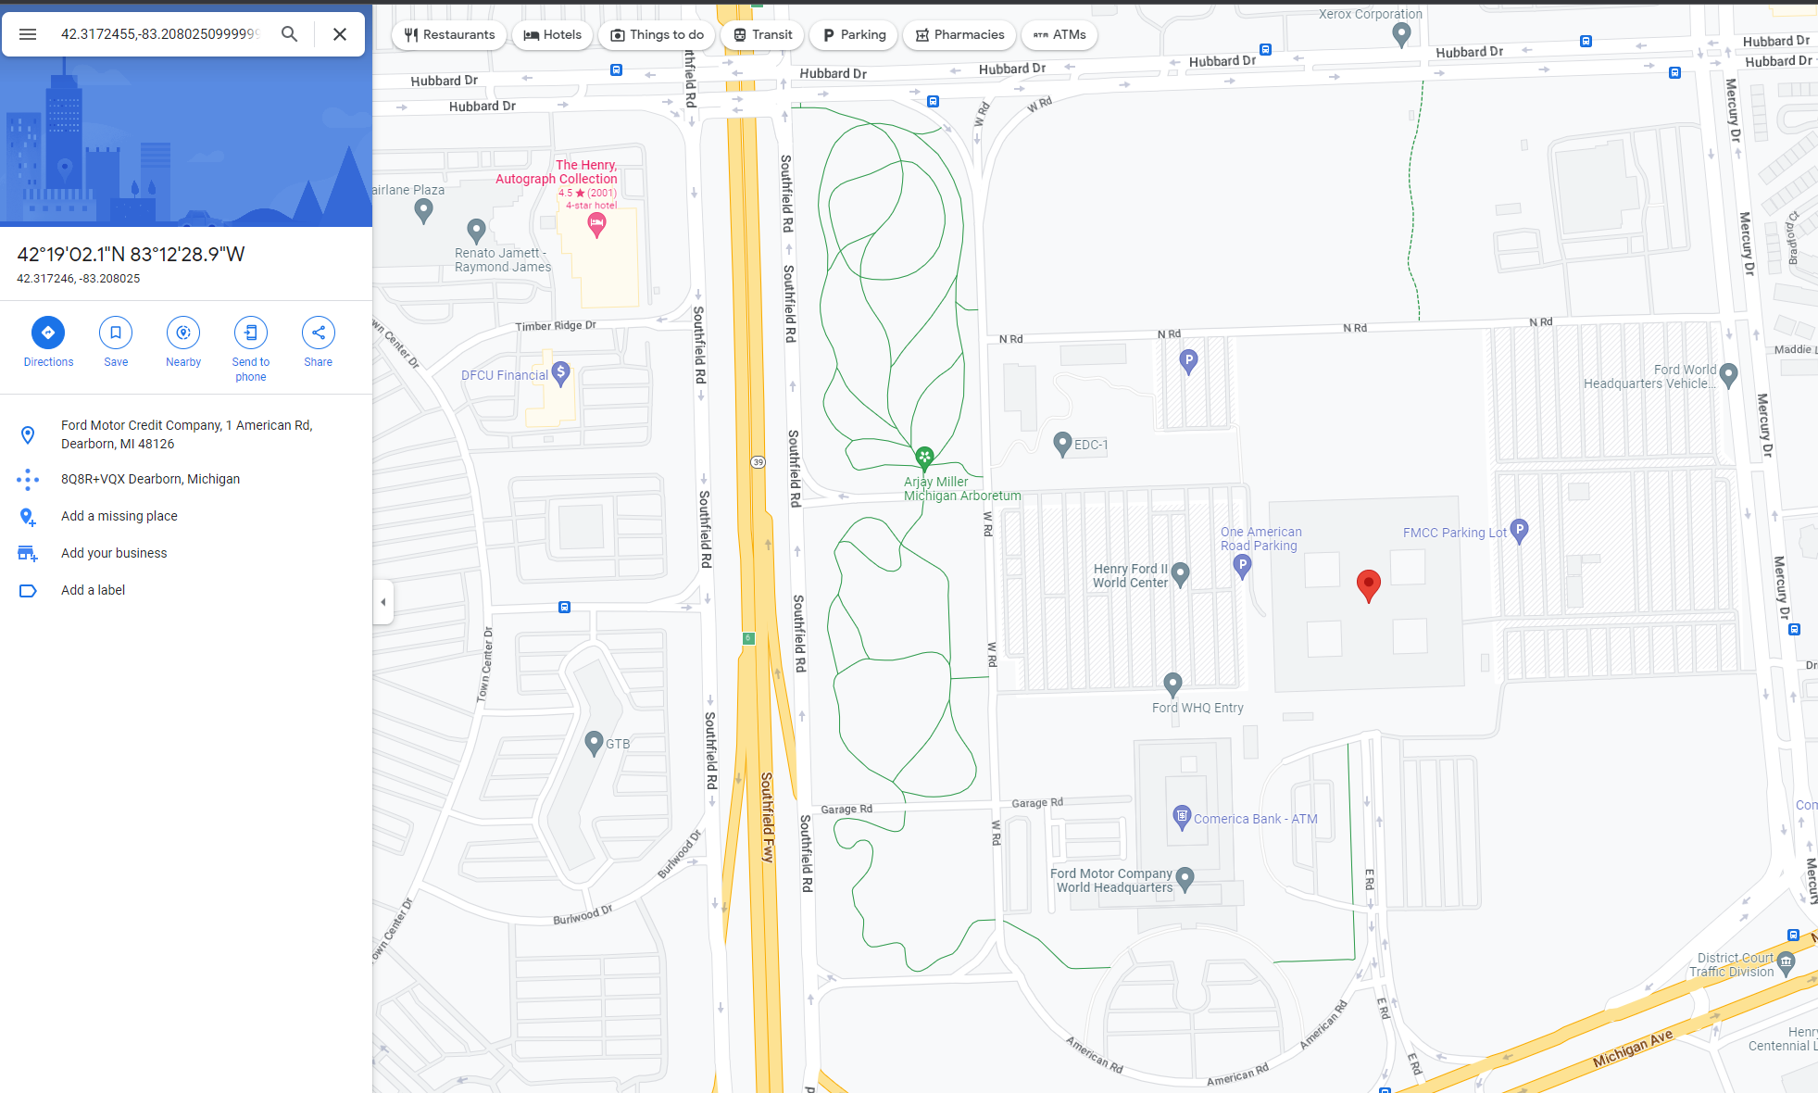
Coordinate 3

Slide 8
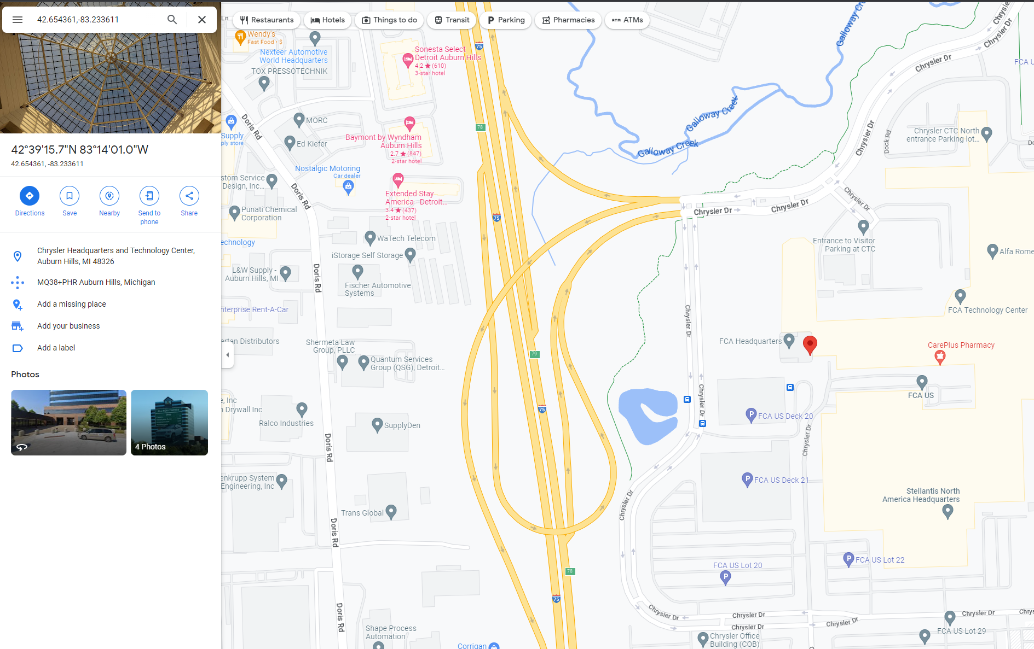
Coordinate 4

Slide 9
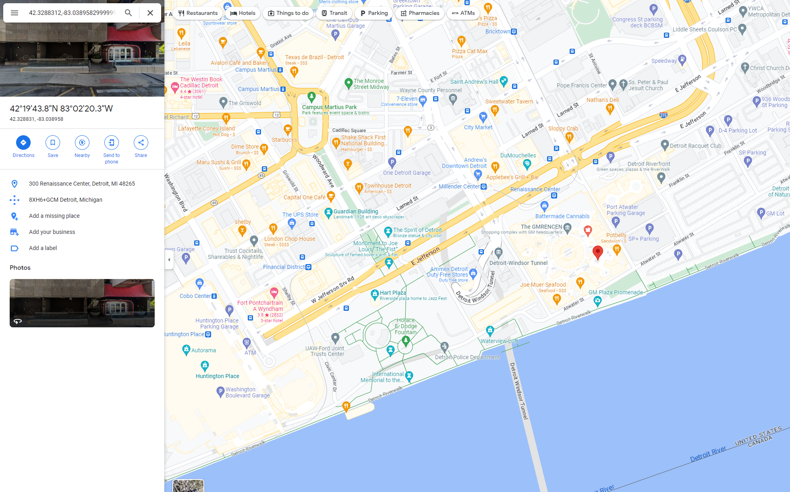
Coordinate 5

Slide 10
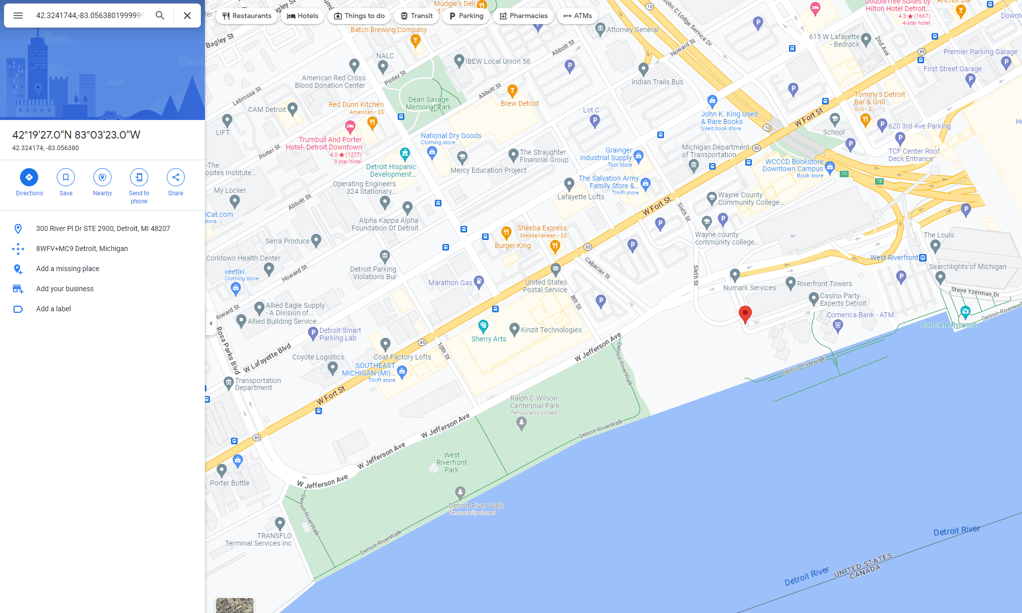
Coordinate 6

Slide 11
Locations - Comprehensible
300 River PI Dr STE 2900, Detroit, MI 48207 "42.3241744,-83.05638019999998“
S Telegraph Rd, Dearborn, MI 48124 "42.286628,-83.270595"
Ford Motor Credit Company, 1 American Rd, Dearborn, MI 48126 "42.3172455,-83.20802509999998"
Chrysler Headquarters and Technology Center, Auburn Hills, MI 48326 "42.654361,-83.233611"
300 Renaissance Center, Detroit, MI 48265 "42.3288312,-83.03895829999999"
300 River PI Dr STE 2900, Detroit, MI 48207 "42.3241744,-83.05638019999998“

Slide 12
Decision

Slide 13
Conclusion
Confirmed going to various auto manufacturers
Cannot confirm selling source code – lack of information

